Slide 1
AngularJS
Introduction to AngularJS
Notes:
Add instructor notes here.

Slide 2

Lesson Objectives
JavaScript fundamentals
MV* Frameworks
AngularJS Fundamentals
Notes:
Add instructor notes here.

Slide 3
1.1: JavaScript Fundamentals JavaScript fundamentals
Browser gets the HTML text of the page, parses it into DOM structure, lays out the content of the page, and styles the content before it gets displayed.
HTML is great for declaring static documents, but it falters when we try to use it for declaring dynamic views in web-applications.
JavaScript has become one of the most popular client side scripting language on the web which is used to create dynamic views in web-applications.
JavaScript plays a major role in the usage of ajax, user experience and responsive web design.
DOM manipulation libraries like jQuery simplifies client side scripting, but it is not solving the problem of handling separation of concerns.
Fortunately there are few libraries and frameworks are available to accomplish this task.
Notes:
Add instructor notes here.

Slide 4
1.1: JavaScript Fundamentals Objects in JavaScript
JavaScript is an object oriented language. In JavaScript we can define our own objects and assign methods, properties to it.
In JavaScript objects are also associative arrays (or) hashes (key value pairs).
Assign keys with obj[key] = value or obj.name = value
Remove keys with delete obj.name
Iterate over keys with for(key in obj), iteration order for string keys is always in definition order, for numeric keys it may change.
Properties, which are functions, can be called as obj.method(). They can refer to the object as this. Properties can be assigned and removed any time.
A function can create new objects when run in constructor mode as new Func(params). Names of such functions are usually capitalized
Notes:
Add instructor notes here.

Slide 5
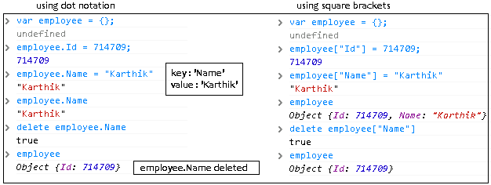
1.1: JavaScript Fundamentals Creating objects
An empty object can be creating using
obj = new Object(); (or) obj = { };
It stores values by key, with that we can assign or delete it using "dot notation" or "Square Brackets" (associative arrays).
Notes:
Add instructor notes here.

Slide 6
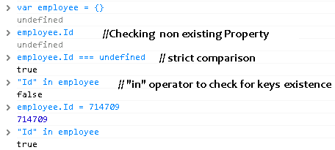
1.1: JavaScript Fundamentals Checking for non existing property in object
If the property does not exist in the object , then undefined is returned
To check whether key existence we can use in operator
Notes:
Add instructor notes here.

Slide 7
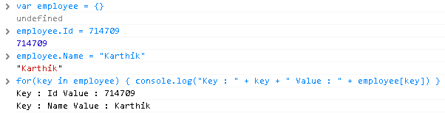
1.1: JavaScript Fundamentals Iterating over object keys
We can iterate over keys using for .. In
Notes:
Add instructor notes here.

Slide 8
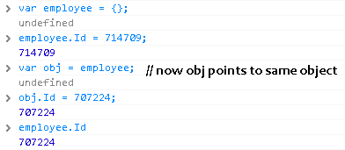
1.1: JavaScript Fundamentals Object reference
A variable which is assigned to object actually keeps reference to it.
It acts like a pointer which points to the real data. Using reference variable we can change the properties of object.
Variable is actually a reference, not a value when we pass an object to a function.
Notes:
Add instructor notes here.

Slide 9
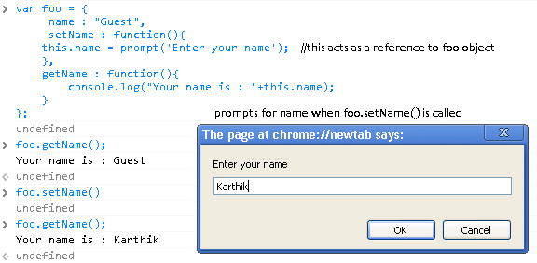
1.1: JavaScript Fundamentals this keyword
When a function is called from the object, this becomes a reference to this object.
Notes:
Add instructor notes here.

Slide 10
1.1: JavaScript Fundamentals Constructor Function
We can create an object using obj = {…..}
Another way of creating an object in JavaScript is to construct it by calling a function with new directive ( Constructor function). Constructor functions should be in Pascal case.
It takes this, which is initially an empty object, and assigns properties to it. The result is returned (unless the function has explicit return).
Notes:
Add instructor notes here.

Slide 11
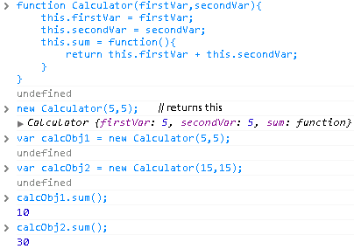
1.1: JavaScript Fundamentals Constructor Function
Notes:
Add instructor notes here.

Slide 12
1.1: JavaScript Fundamentals Prototypal inheritance
In JavaScript, the inheritance is prototype-based. Instead of class inherits from other class, an object inherits from another object.
object inherits from another object using the following syntax.
childObject.__proto__ = baseObject
Above mentioned syntax provided by Chrome / FireFox. In other browsers the property still exists internally, but it is hidden
childObject = Object.create(baseObject)
ConstructorFunction.prototype = baseObject
Above mentioned syntax works with all modern browsers.
Notes:
Add instructor notes here.

Slide 13
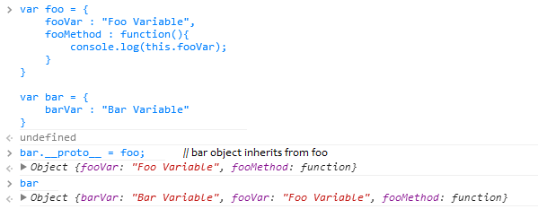
1.1: JavaScript Fundamentals Prototypal inheritance using __proto__
Notes:
Add instructor notes here.

Slide 14
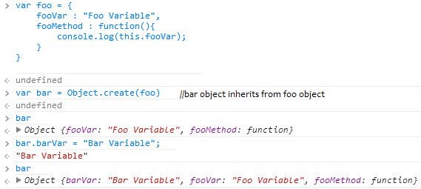
1.1: JavaScript Fundamentals Prototypal inheritance using Object.create()
Notes:
Add instructor notes here.

Slide 15
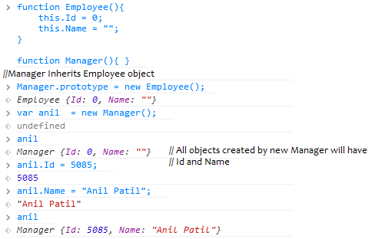
1.1: JavaScript Fundamentals Prototypal inheritance using prototype
Notes:
Add instructor notes here.

Slide 16
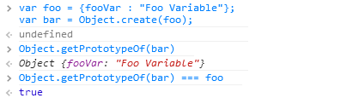
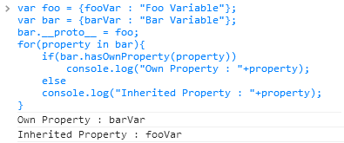
1.1: JavaScript Fundamentals Prototypal inheritance
Object.getPrototypeOf(obj) returns the value of obj.__proto__.
for..in loop lists properties in the object and its prototype chain. obj.hasOwnProperty(prop) returns true if property belongs to that object.
Notes:
Add instructor notes here.

Slide 17
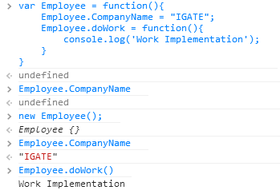
1.1: JavaScript Fundamentals Static variables and methods
In JavaScript we can directly put data into function object which acts like Static member.
Static Members need to be accessed directly by Object name, cannot be accessed by reference variable. Static members gets created when the first object gets created.
Notes:
In JavaScript :
private variables are declared with the 'var' keyword inside the object, and can only be accessed by private functions and privileged methods.
private functions are declared inline inside the object's constructor (or alternatively may be defined via var functionName=function(){...}) and may only be called by privileged methods (including the object's constructor).
privileged methods are declared with this.methodName=function(){...} and may invoked by code external to the object.
public properties are declared with this.variableName and may be read/written from outside the object.
public methods are defined by Classname.prototype.methodName = function(){...} and may be called from outside the object.
prototype properties are defined by Classname.prototype.propertyName = someValue
static properties are defined by Classname.propertyName = someValue
Add instructor notes here.

Slide 18
1.1: JavaScript Fundamentals JavaScript Functions
JavaScript treats functions as objects(first-class functions).
In JavaScript functions can be instantiated, returned by other functions, stored as elements of arrays and assigned to variables.
A function with no name is called an anonymous function.
Closure is a function to which the variables of the surrounding context are bound by reference.
JavaScript function acts as a constructor when we use it together with the new operator
Notes:
Add instructor notes here.

Slide 19
1.1: JavaScript Fundamentals Working with JavaScript Functions
Declaring the function anonymously
Invoking the anonymous function. Function executes immediately after declaration.
function(){
console.log(‘IGATE');
}
(function(){
console.log(‘IGATE');
})();
Notes:
Add instructor notes here.

Slide 20
1.1: JavaScript Fundamentals Working with JavaScript Functions
Declaring a named function. function doSomething will be available inside the scope in which it’s declared.
Assigning function to a variable.
function doSomething(){
console.log('IGATE');
}
/* Inner Scope */
(function(){
doSomething();
})();
var doSomething = function(){
console.log(‘IGATE');
}
Notes:
Add instructor notes here.

Slide 21
1.1: JavaScript Fundamentals Working with JavaScript Functions
/*Anonymous Closures*/
(function(){
var data = "Closing the variables inside the function from the rest of the world"
console.log(‘Closure Invoked');
})();
var employee = function(){
this.employeeId = 0;
this.name = "";
};
/* JavaScript function acts as a constructor */
var emp = new employee();
Notes:
Add instructor notes here.

Slide 22
Demo
Working-with-Javascript-Functions
Closure-Demo
Notes:
Add instructor notes here.

Slide 23
1.2: MV* Frameworks MV* Frameworks
MV* Frameworks are designed to make our code easier to maintain and to improve the user experience
MV* framework is nothing but the popular patterns like
Model-View-Controller(MVC)
Model-View-ViewModel(MVVM)
Model-View-Presenter(MVP)
MVW(hatever works for you)
Idea of all the patterns is to separate Model, View and the Controller (the logic that hooks up model and view)
AngularJS, Backbone.JS, Knockout, EmberJS, Meteor, ExtJS are some of the famous MV* framework libraries.
Notes:
Add instructor notes here.

Slide 24
1.2: MV* Frameworks Model, View and Controllers
Model
Contains the data which we are using in our application
View
Displays the data to the user and read the user input.
Controller
Format the data for views and handle application state.
Notes:
Add instructor notes here.

Slide 25
1.3: AngularJS Introduction Introduction to AngularJS
AngularJS is an open source JavaScript library that is sponsored and maintained by Google.
Developed in 2009 by Misko Hevery. Publicly released as version 0.9.0 in Oct 2010.
AngularJS makes it easy to build interactive, modern web applications by increasing the level of abstraction between the developer and common web app development tasks by following Model–View–Controller (MVC) pattern.
AngularJS lets you to extend HTML vocabulary for your application. The resulting environment is extraordinarily expressive, readable, and quick to develop.
AngularJS helps us to create single page applications easily.
No page refresh on page change and different data on each page
Notes:
AngularJS is a client-side technology, written entirely in JavaScript.
It works with the long-established technologies of the web (HTML, CSS, and JavaScript) to make the development of web apps easier and faster than ever before.
It is a framework that is primarily used to build single-page web applications. AngularJS makes it easy to build interactive, modern web applications by increasing the level of abstraction between the developer and common web app development tasks.
The AngularJS team describes it as a “structural framework for dynamic web apps.”
Single page applications can be done with just JavaScript and AJAX calls, Angular will make this process easier
Add instructor notes here.

Slide 26
1.3: AngularJS Introduction AngularJS Features
Extending HTML to add dynamic nature so that we can build modern web applications with separation of application logic, data models, and views templates
Two way binding
It synchronize the data between model and view, view component gets updated when the model get change and vice versa, no need for events to accomplish this
Templates can be created using HTML itself
Testability is the primary consideration in AngularJS. It supports both isolated unit tests and Integrated end to end test
It also supports Routing, Filtering, Ajax calls, data binding, caching, history, and DOM manipulation.
Notes:
HTML is designed for static webpages, but developing a dynamic site with HTML we need to do many tricks to achieve what we want. With AngularJS extending the HTML it is really simple to make a dynamic site in a proper MVC structure.
With AngularJS we can achieve
Create a template and reuse it in application multiple times.
Can bind data to any element in two ways
Can directly call the code-behind code in your html.
Easily validate forms and input fields before submitting it.
Can control complete DOM structure show/hide, changing everything with AngularJS properties.
In other JavaScript frameworks, we are forced to extend from custom JavaScript objects and manipulate the DOM from the outside. For instance, using jQuery, to add a button in the DOM, we’ll have to know where we’re putting the element and insert it in the appropriate place.
var $btn = $("<button>jQuery Button</button>");
$("#target").append($btn);
AngularJS, on the other hand, augments HTML to give it native Model-View-Controller (MVC) capabilities. It enables the developer, to encapsulate a portion of entire page as one application, rather than forcing the entire page to be an AngularJS application.
This distinction is particularly beneficial, if the web application already includes another framework or if there is a need to make a portion of the page dynamic while the rest operates as a static page or is controlled by another JavaScript framework.
Use the demos mentioned below to demonstrate AngularJS features
AngularJs-PhoneBookApp
AngularJs-Service
AngularJs-Filters
AngularJs-Routing

Slide 27
1.3: AngularJS Introduction AngularJS Controller and Scope
Controllers primary responsibility is to create scope object ($scope), It also constructs the model on $scope and provides commands for the view to act upon $scope.
Scope communicate with view in two way communication
Scope exposes model to view, but scope is not a model. Model is nothing but the data present in the scope.
View can be binded to the functions on the scope.
We can modify the model using the methods available on the scope.
Controller
Scope
View
$scope is the glue between Controller and Model
Notes:
Scopes are a core fundamental of any Angular app. They are used all over the framework. $scope object is where we define the business functionality of the application, the methods in our controllers, and properties in the views.
Scopes are the source of truth for the application state. Because of this live binding, we can rely on the $scope to update immediately when the view modifies it, and we can rely on the view to update when the $scope changes.
$scopes in AngularJS are arranged in a hierarchical structure so that we can reference properties on parent $scopes.
It is ideal to contain the application logic in a controller and the working data on the scope of the controller.
Add instructor notes here.

Slide 28
1.3: AngularJS Introduction AngularJS Model
The model is simply a plain old JavaScript object, does not use getter/setter methods or have any special framework-specific needs.
Changes are immediately reflected in the view via the two-way binding feature.
All model objects stem from scope object.
Typically model objects are initialized in controller code with syntax like:
$scope.companyName = "IGATE";
In the HTML template, that model variable would be referenced in curly braces such as: {{companyName}} without the $scope prefix.
Notes:
Add instructor notes here.

Slide 29
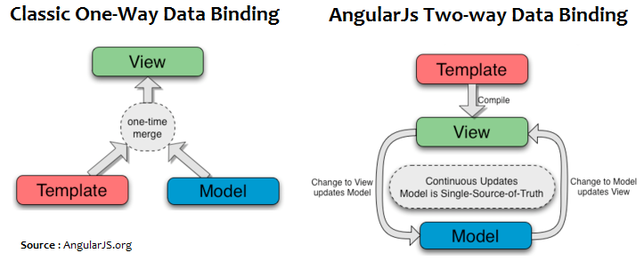
1.3: AngularJS Introduction AngularJS View and Templates
The View in AngularJS is the compiled DOM.
View is the product of $compile merging the HTML template with $scope.
In Angular, templates are written with HTML that contains Angular-specific elements and attributes. Angular combines the template with information from the model and controller to render the dynamic view that a user sees in the browser
Notes:
Most other templating systems consume a static string template and combine it with data, resulting in a new string. The resulting text is then innerHTMLed into an element. This means that any changes to the data need to be re-merged with the template and then innerHTMLed into the DOM.
Angular is different. The Angular compiler consumes the DOM, not string templates. The result is a linking function, which when combined with a scope model results in a live view. The view and scope model bindings are transparent. The developer does not need to make any special calls to update the view. And because innerHTML is not used, you won't accidentally clobber user input. Furthermore, Angular directives can contain not just text bindings, but behavioral constructs as well.
The Angular approach produces a stable DOM. The DOM element instance bound to a model item instance does not change for the lifetime of the binding. This means that the code can get hold of the elements and register event handlers and know that the reference will not be destroyed by template data merge.
Add instructor notes here.

Slide 30
Demo
AngularJs-MVC
Notes:
Add instructor notes here.

Slide 31
1.3: AngularJS Introduction AngularJS Modules
A module is the overall container used to group AngularJS code. It consists of compiled services, directives, views controllers, etc.
Module is like a main method that instantiates and wires together the different parts of the application.
Modules declaratively specify how an application should be bootstrapped.
The Angular module API allows us to declare a module using the angular.module() API method.
When declaring a module, we need to pass two parameters to the method. The first is the name of the module we are creating. The second is the list of dependencies, otherwise known as injectables.
angular.module('myApp', []); // setter method for defining Angular Module.
angular.module('myApp'); // getter method for referencing Angular Module.
Notes:
Advantages of Modules
Keeping our global namespace clean
Making tests easier to write and keeping them clean so as to more easily target isolated functionality
Making it easy to share code between applications
Allowing our app to load different parts of the code in any order
When writing large applications, we can create several different modules to contain our logic. Creating a module for each piece of functionality gives us the advantage of isolation to write and test.
Add instructor notes here.

Slide 32
1.3: AngularJS Introduction AngularJs Expressions
Expressions {{expression}} are JavaScript like code snippets.
In Angular, expressions are evaluated against a scope object.
AngularJS let us to execute expressions directly within our HTML pages.
Expressions are generally placed inside a binding and typically it has variable names set in the scope object.
Expression can also hold computational codes like {{3 * 3}}, but we cannot directly use JavaScript syntax like {{Math.random()}}, conditionals, loops or exceptions inside it.
<div>{{3 * 3}}</div> returns 9
<div>{{'Karthik'+' '+'Muthukrishnan'}}</div> returns Karthik Muthukrishnan
<div>{{['Ganesh','Abishek','Karthik','Anil'][2]}}</div> returns Karthik
Notes:
Add instructor notes here.

Slide 33
1.3: AngularJS Introduction $rootScope
When Angular starts to run and generate the view, it will create a binding from the root ng-app element to the $rootScope.
$rootScope is the eventual parent of all $scope objects and it is set when the module initializes via run method.
The $rootScope object is the closest object we have to the global context in an Angular app. It’s a bad idea to attach too much logic to this global context.
<div ng-app="myApp"> <h1>{{companyName}}</h1> </div>
<script>
var app= angular.module("myApp",[]);
app.run(function($rootScope){
$rootScope.companyName = "IGATE";
$rootScope.printCompanyName = function() {
console.log($rootScope.companyName);
}
});
</script>
Notes:
Run blocks - get executed after the injector is created and are used to kickstart the application. Only instances and constants can be injected into run blocks. This is to prevent further system configuration during application run time.
Run blocks are the closest thing in Angular to the main method. It is executed after all of the service have been configured and the injector has been created.
Variables set at the root-scope are available to the controller scope via prototypical inheritance.
Add instructor notes here.
<div ng-app="myApp" ng-controller="myCntrl">
{{company}}
</div>
var app= angular.module("myApp",[]);
app.run(function($rootScope){
$rootScope.companyName = "Microsoft";
$rootScope.printCompanyName = function() {
console.log($rootScope.companyName);
}
});
app.controller("myCntrl",function($scope,$rootScope){
console.debug($rootScope.companyName);
$rootScope.companyName= "IGATE"; //Changing Value
$scope.company = $rootScope.companyName;
});

Slide 34
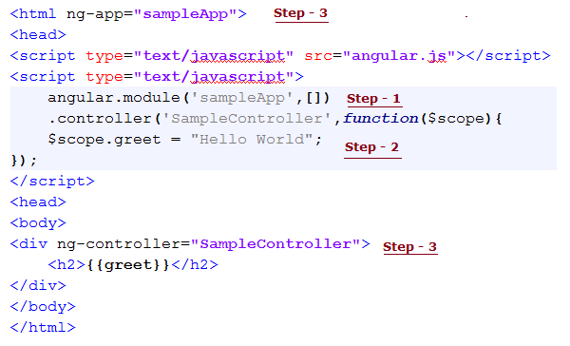
1.3: AngularJS Introduction Steps for Coding Hello World in AngularJs
Step 1: Declare the module
Step 2: Declare the controller and set the properties (or) function to the scope.
Step 3: Bootstrap angularjs using ng-app and define the controller, so that the properties which we have set in the controller can be consumed in the view(HTML).
Notes:
Add instructor notes here.

Slide 35
Demo
AngularJs-Modules
Notes:
Add instructor notes here.

Slide 36
1.3: AngularJS Introduction Dependency Injection
Dependency injection is a design pattern that allows for the removal of hard-coded dependencies, thus making it possible to remove or change them at run time.
function Foo(object) {
this.object = object;
}
Foo.prototype.showDetails = function(data) {
this.object.display(data);
}
var greeter = {
display : function(msg){
alert(msg);
}
}
var foo = new Foo(greeter);
foo.showDetails("IGATE");
Notes:
Add instructor notes here.

Slide 37
1.3: AngularJS Introduction Dependency Injection
At runtime, the Foo doesn’t care how it gets the dependency, so long as it gets it. In order to get that dependency instance into Foo, the creator of Foo is responsible for passing in the Foo dependencies when it’s created.
This ability to modify dependencies at run time allows us to create isolated environments that are ideal for testing. We can replace real objects in production environments with mocked ones for testing environments.
In AngularJS at run time, an injector will create instances of the dependencies and pass them along to the dependent consumer.
Notes:
Add instructor notes here.

Slide 38
Demo
Dependency Demo
Notes:
Add instructor notes here.

Slide 39
1.3: AngularJS Introduction AngularJS Services
Services provide a method for us to keep data around for the lifetime of the app and communicate across controllers in a consistent manner.
Services are singleton objects that are instantiated only once per app (by the $injector) and lazyloaded (created only when necessary).
We need to put our business logic in Services.
We will discuss in detail about Services, later in this course.
Notes:
Add instructor notes here.

Slide 40

1.3: AngularJS Introduction injector Service
Angular uses the injector for managing lookups and instantiation of dependencies. We will very rarely work directly with injector service
injector is responsible for handling all instantiations of our Angular components, including app modules, directives, controllers, etc.
injector is responsible for instantiating the instance of the object and passing in any of its required dependencies. Injector API has following methods.
annotate()
The annotate() function returns an array of service names that are to be injected into the function when instantiated.
Notes:
Add instructor notes here.

Slide 41

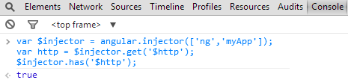
1.3: AngularJS Introduction injector Service
get()
The get() method returns an instance of the service which takes the name argument. (the name of the instance we want to get).
has()
The has() method returns true if the injector knows that a service exists in its registry and false if it does not.
Notes:
Add instructor notes here.

Slide 42


1.3: AngularJS Introduction injector Service
instantiate()
The instantiate() method creates a new instance of the JavaScript type. It takes a constructor and invokes the new operator with all of the arguments specified.
invoke()
The invoke() method invokes the method and adds the method arguments from the $injector. The invoke() method returns the value that the fn function returns
Notes:
Add instructor notes here.

Slide 43
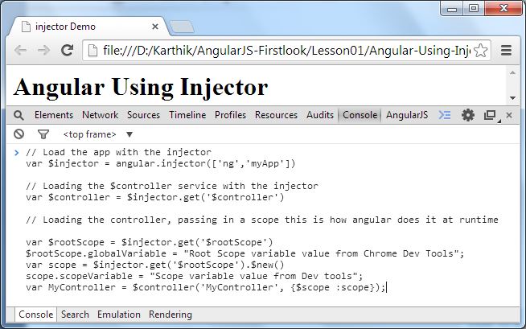
1.3: AngularJS Introduction How Angular uses injector Service
Notes:
Add instructor notes here.
// Load the app with the injector
var $injector = angular.injector(['ng','myApp'])
// Loading the $controller service with the injector
var $controller = $injector.get('$controller')
// Loading the controller, passing in a scope this is how angular does it at runtime
var $rootScope = $injector.get('$rootScope')
$rootScope.globalVariable = "Root Scope variable value from Chrome Dev Tools";
var scope = $injector.get('$rootScope').$new()
scope.scopeVariable = "Scope variable value from Dev tools";
var MyController = $controller('MyController', {$scope :scope});

Slide 44
Demo
Angular-Using-Injector
Injector-Demo
Notes:
Run this demo by typing the contents shown in
Previous slide using Chrome Developer tools

Slide 45
1.3: AngularJS Introduction Config and Run Method
angular.Module type has config() and run() method
config(configFn)
We can use this method to register the work which needs to be performed on module loading.
It will be very useful for configuring the service.
run(initializationFn)
We can use this method to register the work which needs to be performed when the injector is done loading all modules.
Notes:
Add instructor notes here.

Slide 46
Demo
Config-Demo
Notes:
Run this demo by typing the contents shown in
Previous slide using Chrome Developer tools

Slide 47
1.3: AngularJS Introduction jqLite
Angular.js comes with a simple compatible implementation of jQuery called jqLite
Angular doesn’t depend on jQuery. In order to keep Angular small, Angular implements only a subset of the selectors in jqLite, so error will occurs when a jqLite instance is invoked with a selector other than this subset.
We can include a full version of jQuery, which Angular will automatically use. So that all the selectors will be available.
If jQuery is available, angular.element is an alias for the jQuery function. If jQuery is not available, angular.element delegates to Angular's built-in subset of jQuery, called "jQuery lite" or "jqLite."
All element references in Angular are always wrapped with jQuery or jqLite; they are never raw DOM references.
Notes:
Angular's jqLite
jqLite provides only the following jQuery methods:
addClass(), after() , append() , attrclone(), contents() ,
css(), data(), detach(), empty(), eq(), hasClass(),
html(), prepend(), prop(), ready(), remove(),
removeAttr(), removeClass(), removeData(), replaceWith() ,
text(), toggleClass(), val() & wrap()
children(), parent(), next() - Does not support selectors,
find() - Limited to lookups by tag name,
bind() - Does not support namespaces, selectors or eventData,
on() - Does not support namespaces, selectors or eventData,
off() - Does not support namespaces or selectors,
one() - Does not support namespaces or selectors
unbind() - Does not support namespaces
triggerHandler() - Passes a dummy event object to handlers.
Add instructor notes here.

Slide 48
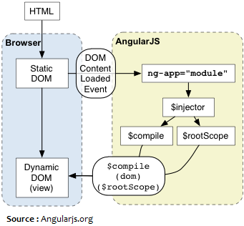
1.3: AngularJS Introduction How AngularJs Works
$compile compiles DOM into a template function that can be used to link scope and the view together.
Notes:
Angular initializes automatically upon DOMContentLoaded event or when the angular.js script is evaluated if at that time document.readyState is set to 'complete'.
At this point Angular looks for the ng-app directive which designates your application root.
If the ng-app directive is found then Angular will:
Load the module associated with the directive.
Create the application injector
Compile the DOM treating the ng-app directive as the root of the compilation.
This allows you to tell it to treat only a portion of the DOM as an Angular application.
Add instructor notes here.

Slide 49

Summary
JavaScript objects are also associative arrays
In JavaScript, the inheritance is prototype-based.
JavaScript treats functions as objects(first-class functions).
JavaScript function acts as a constructor when we use it together with the new operator.
Angular thinks of HTML as if it had been designed to build applications instead of documents.
Angular supports unit tests and end to end tests.
Controller is the central component in an angular application.
Notes:
Add the notes here.
Add instructor notes here.

Slide 50
Summary
Creating the scope is the primary responsibility of the controller.
$scope is the glue between Controller and Model
View can bind to the properties as well as functions on the scope.
Expressions only supports a subset of JavaScript. We can create an array in expression.
Using Dependency Injection we can replace real objects in production environments with mocked ones for testing environments
Notes:
Add the notes here.
Add instructor notes here.

